Slide 1

Image Enhancement Technique
DEPARTMENT OF ELECTRONICS AND TELECOMMUNICATION ENGINEERING
TRIDENT ACADEMY OF TECHNOLOGY,BHUBANESWAR
Presented by
Name – Soubhagya Ranjan Sukla
Branch - ETC
Semester - 5th
Regd. No – 2301289570

Slide 2
Contents
Introduction
Objective
Image enhancement technique
Application across industries
Conclusion
References

Slide 3
Introduction
Image enhancement is a process used to improve the visual quality of an image by adjusting brightness, contrast, and sharpness. It helps highlight important details and make images clearer for better viewing or analysis.
There are two main approaches to image enhancement:
Spatial Domain Techniques: Operate directly on image pixels (e.g., contrast adjustment, smoothing, sharpening).
Frequency Domain Techniques: Modify the frequency components of the image using transforms (e.g., Fourier Transform).

Slide 4
Objectives
- Improve Visual Quality:
Make the image look better or easier to understand.
- Highlight Important Features:
Show important shapes, edges, or patterns clearly.
- Increase Contrast:
Make dark and light areas easier to see.
- Noise Reduction:
Remove unwanted spots or distortions.
- Facilitate Further Processing:
Prepare the image for other tasks like detection or analysis.
- Enhance Image Details:
To reveal fine structures in scientific or medical imaging.

Slide 5
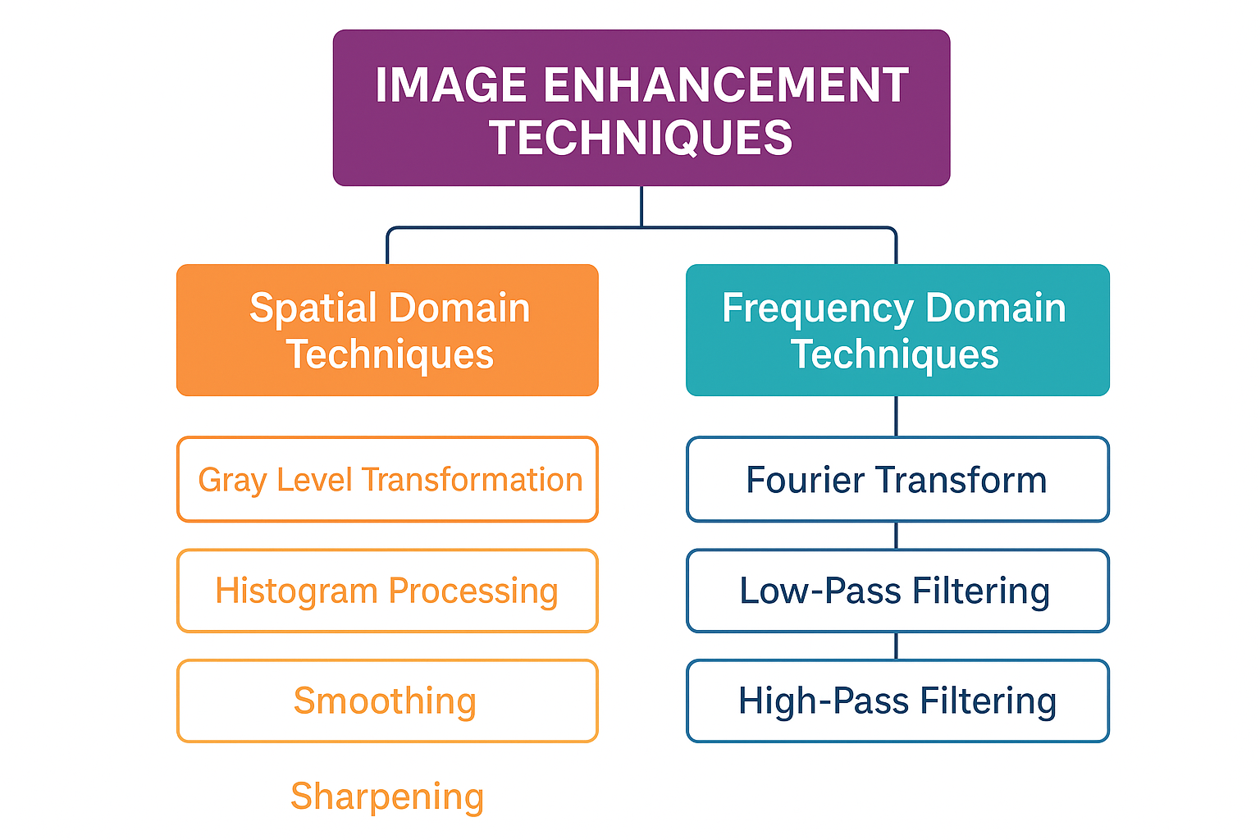

Slide 6
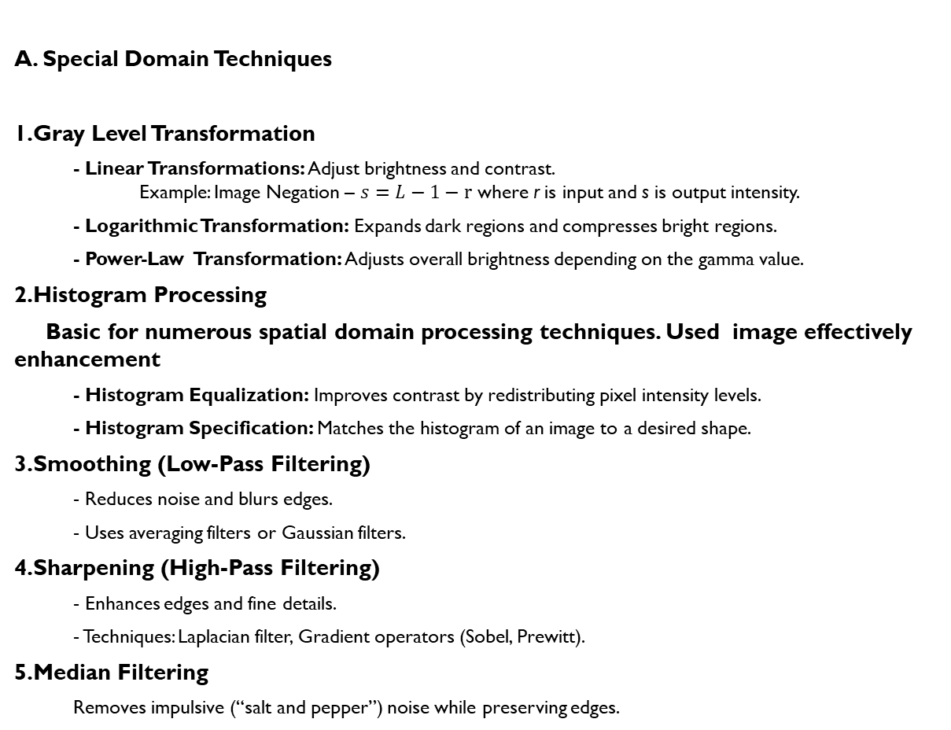
A. Special Domain Techniques
1.Gray Level Transformation
  - Linear Transformations: Adjust brightness and contrast.
  Example: Image Negation – $s=L−1−r$ where r is input and s is output intensity.
  - Logarithmic Transformation: Expands dark regions and compresses bright regions.
  - Power-Law Transformation: Adjusts overall brightness depending on the gamma value.
2.Histogram Processing
Basic for numerous spatial domain processing techniques. Used image effectively enhancement
  - Histogram Equalization: Improves contrast by redistributing pixel intensity levels.
  - Histogram Specification: Matches the histogram of an image to a desired shape.
3.Smoothing (Low-Pass Filtering)
  - Reduces noise and blurs edges.
  - Uses averaging filters or Gaussian filters.
4.Sharpening (High-Pass Filtering)
  - Enhances edges and fine details.
  - Techniques: Laplacian filter, Gradient operators (Sobel, Prewitt).
5.Median Filtering
  Removes impulsive (“salt and pepper”) noise while preserving edges.

Slide 7
B. Frequency Domain Techniques
The concept of filtering is easier to visualize in the frequency domain.
1.Fourier Transform
>Converts an image from spatial domain to frequency domain.
>Helps in emphasizing or suppressing specific frequency components.
2.Low-Pass Filtering
>Removes high-frequency noise and smooths the image.
3.High-Pass Filtering
>Highlights edges and fine structures.
13/9/2025
Image Enhancement techniques

Slide 8
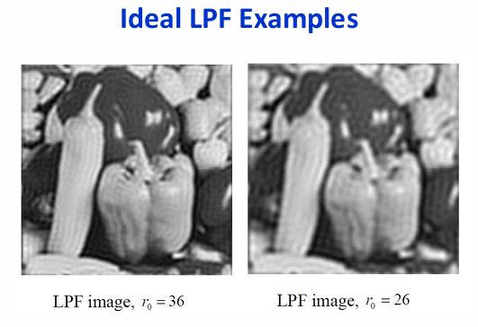
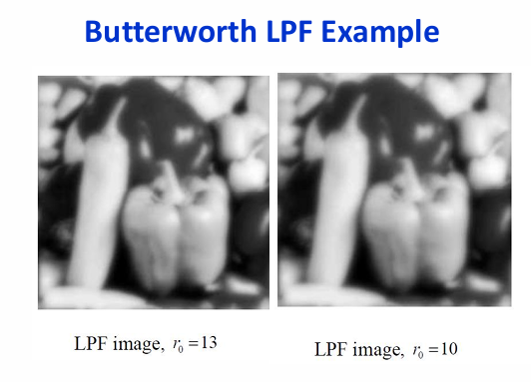

Slide 9
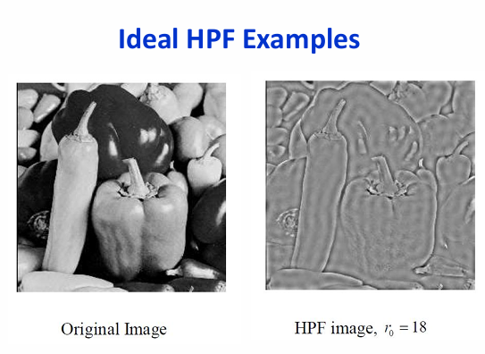
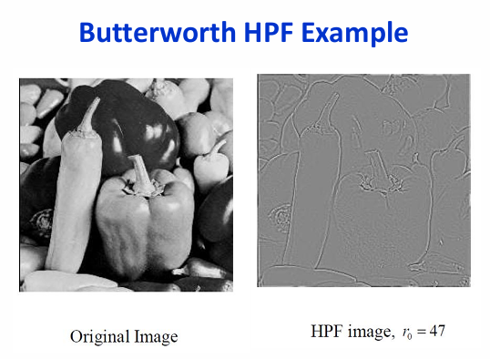

Slide 10
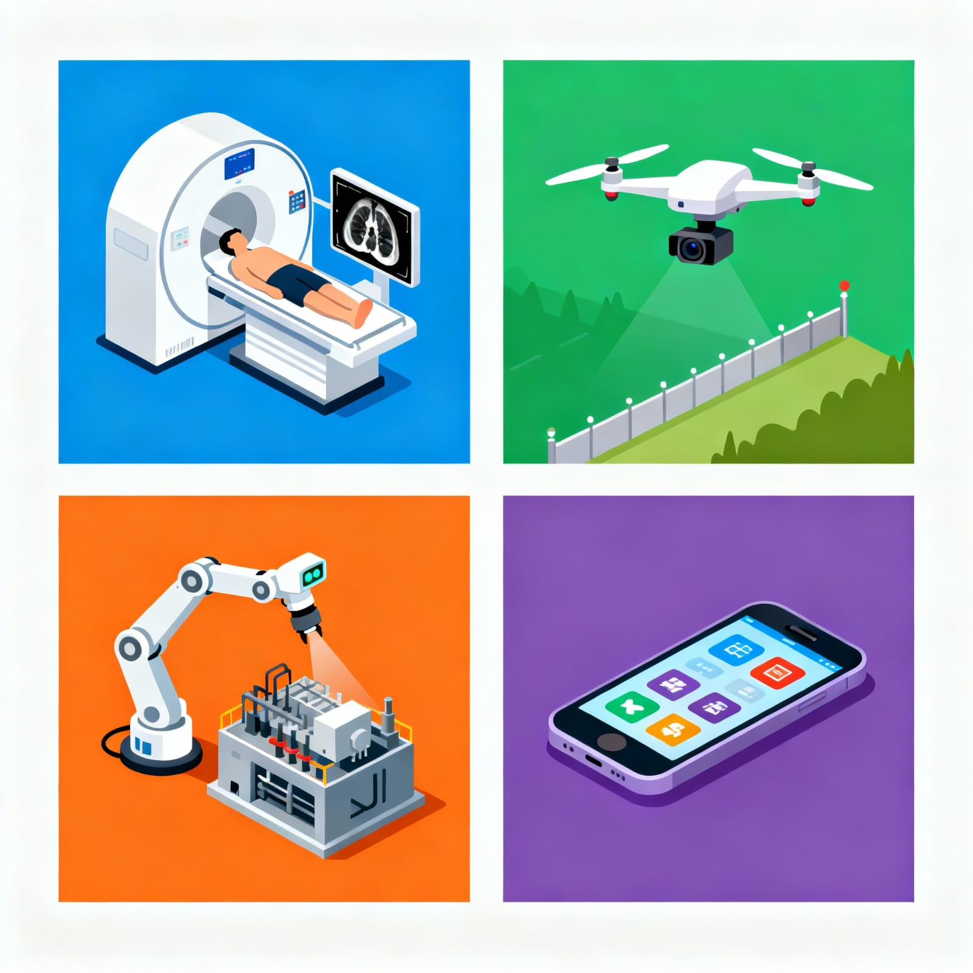
Applications across industries
Enhances CCTV footage, fingerprints, and evidence images.
        1.Medical Image
        2.Defence and Security
        3.Industrial Inspection
        4.Consumer Electronics etc

Slide 11
Conclusion
>Image enhancement is an essential step in digital image processing.
>It improves image quality, enhances visibility of key features, and supports effective analysis across different applications.

Slide 12
References
1. Richard E. Woods, Digital Image Processing, 4th Edition, Pearson Education.
2.Anil K. Jain, Fundamentals of Digital Image Processing, Prentice Hall.
3.B. Chanda & D. Dutta Majumder, Digital Image Processing and Analysis, PHI Learning.
4. Sridhar, Digital Image Processing, Oxford University Press.
5.IEEE Papers and Journals on Image Enhancement and Machine Vision (2015–2024).

Slide 13
Thank
YOU

